Slide 1
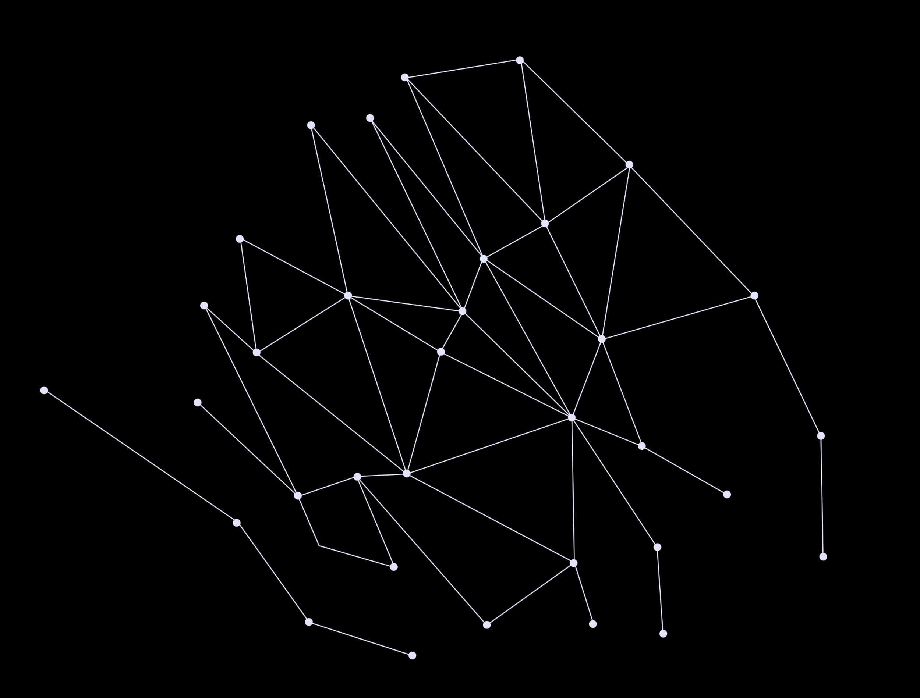



Arab Region Employees Salary Prediction
IT326 - 1st semester
Dr. Hanan Altamimi

Slide 2



Outline
01 | Problem
02 | Data Summarization: Data Information, Graphs
03 | Data Preprocessing: Data Cleaning, Data Transformation, Feature selection
04 | Data Mining Techniques: Classification and findings , Clustering and findings
05 | Results

Slide 3

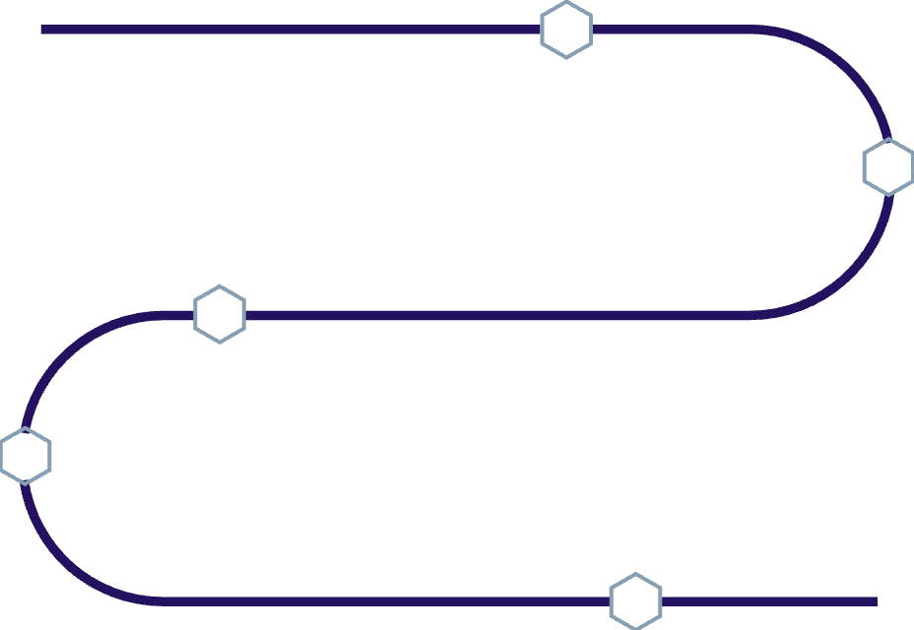





Problem
Education
Location
Years of experience
Department
Job status
Notes:
نقول ان هذي الاشياء تعتمد عليها السالري وان تحديد السالري مشكلة كبيرة وكذا
Many reasons, such as qualifications, country location, and years of experience, can have a significant impact on the salary rate, which leads people in many situations to seek higher pay based on their qualifications or even consider leaving their countries due to differences in salary rates.
In this project, we will study and analyze some employees' data to identify the relationship between various attributes and the salary rate.

Slide 4
Data Summarization
Data Information
our attributes are:
ID
Education
Department
Job status
Location
Start date
Years
Salary
Job rate
Permission
link of the dataset: https://www.kaggle.com/datasets/qusaybtoush1990/employes
Notes:
نقول عدد row

Slide 5
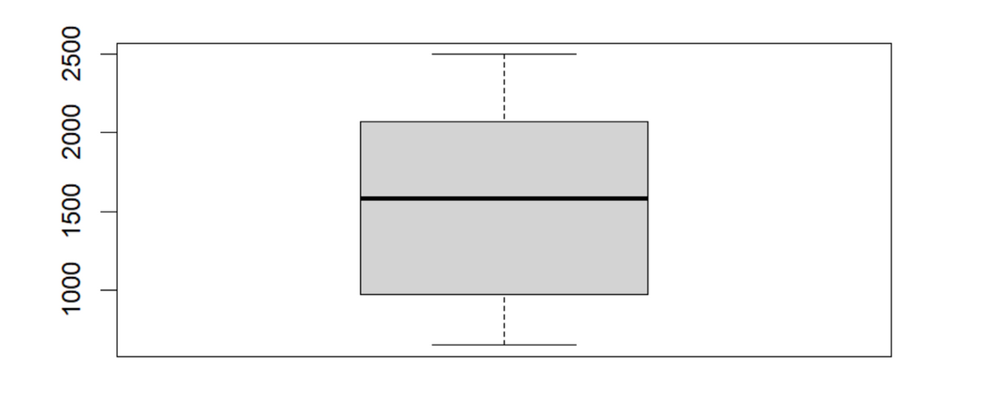
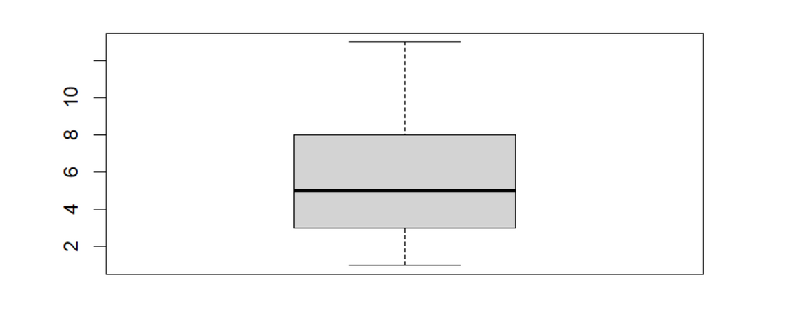
Data Summarization
Data Graphs
Box plot for salary
Box plot for years

Slide 6
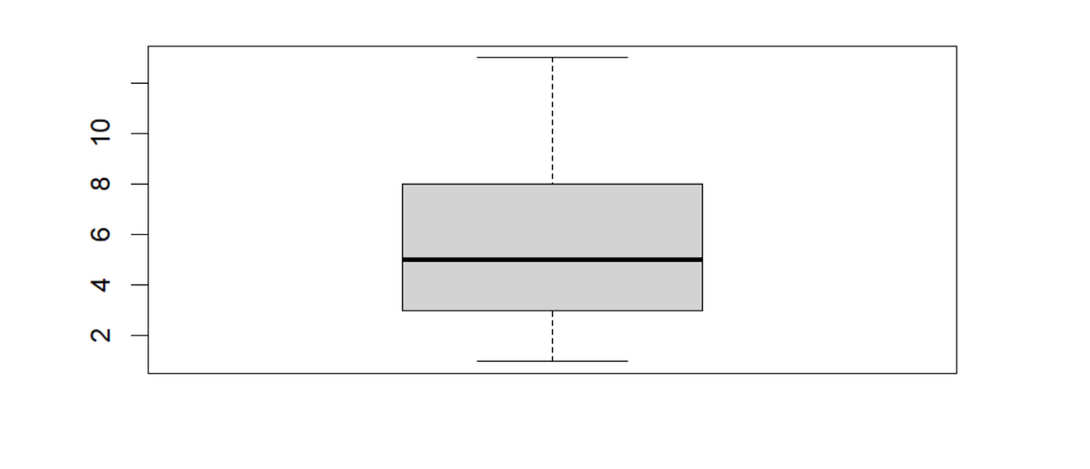
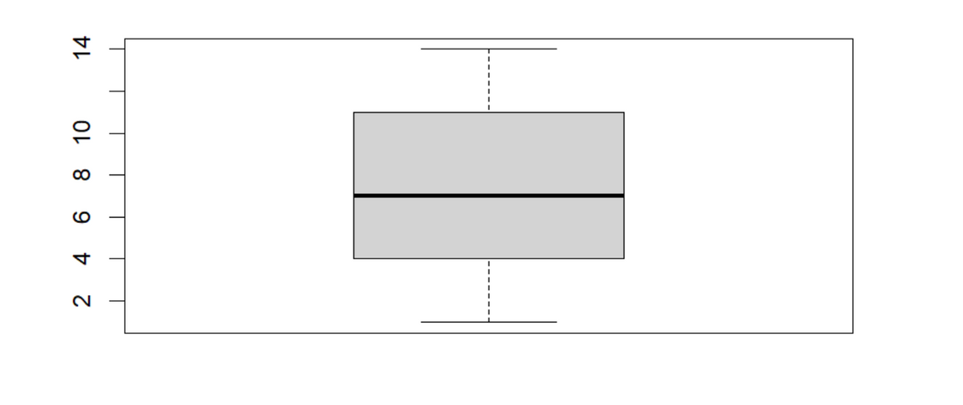
Data Summarization
Data Graphs
Box plot for job rate
Box plot for permissions

Slide 7
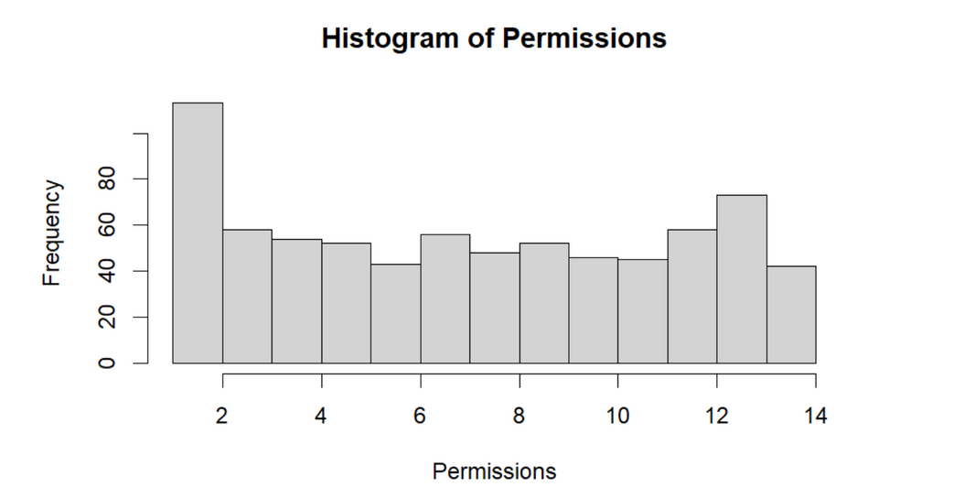
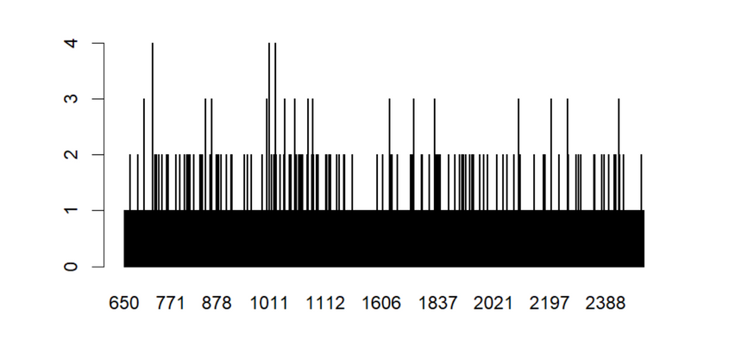
Data Summarization
Data Graphs
Histogram of permissions
Bar Chart for salary

Slide 8
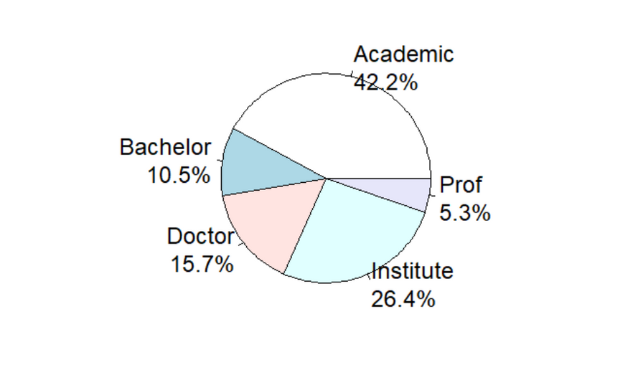
Data Summarization
Data Graphs
Pie chart for Education

Slide 9

Data Preprocessing
We used three Preprocessing techniques:
Data cleaning
Data transformation
Feature selection

Slide 10
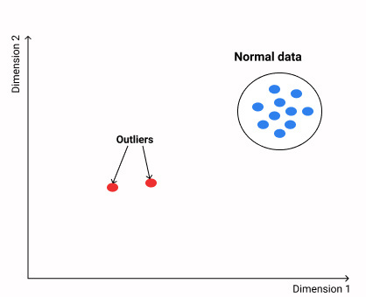

Data Preprocessing
Data cleaning
missing or null values
outliers

Slide 11

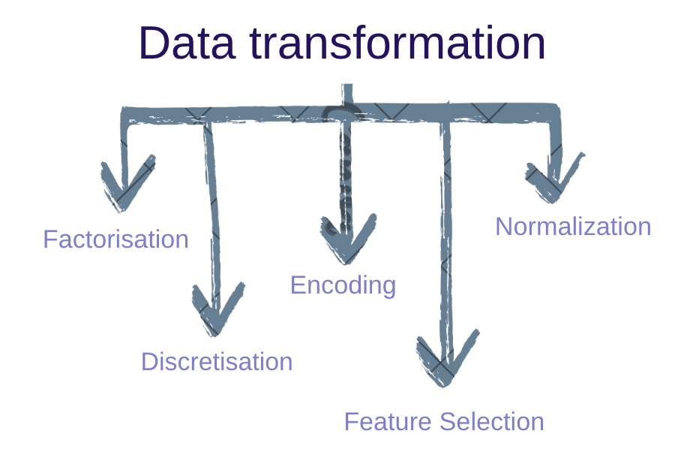
Data Preprocessing
Notes:
نقول وش الاتربيوت اللي استخدمنا لهم كلهم
We used Discretization to arrange the Salary values into intervals and give every interval a suitable label.
We used Encoding to converting categorical data to numerical format. We need to convert the data to be able to do clustering.

Slide 12
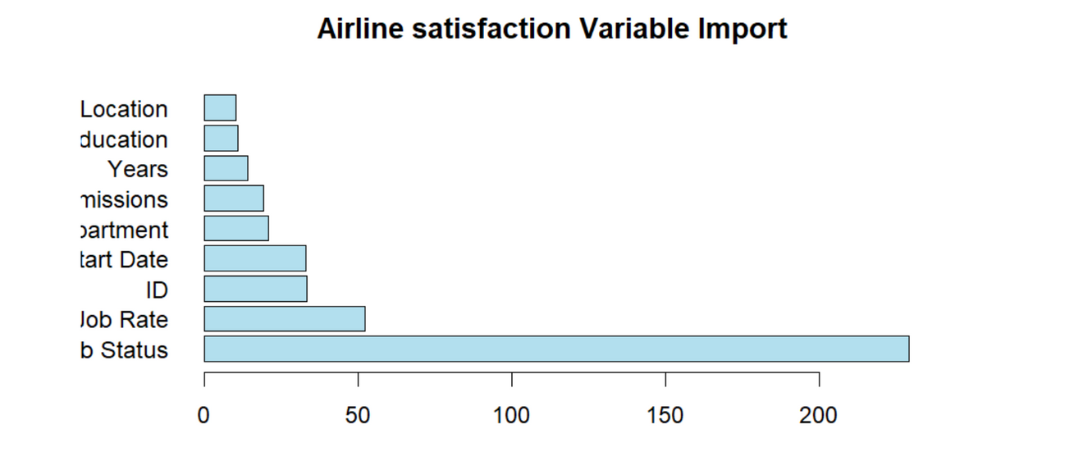
Data Preprocessing
Feature selection
assist in showing the most relevant features, leading to simpler and more interpretable models.

Slide 13
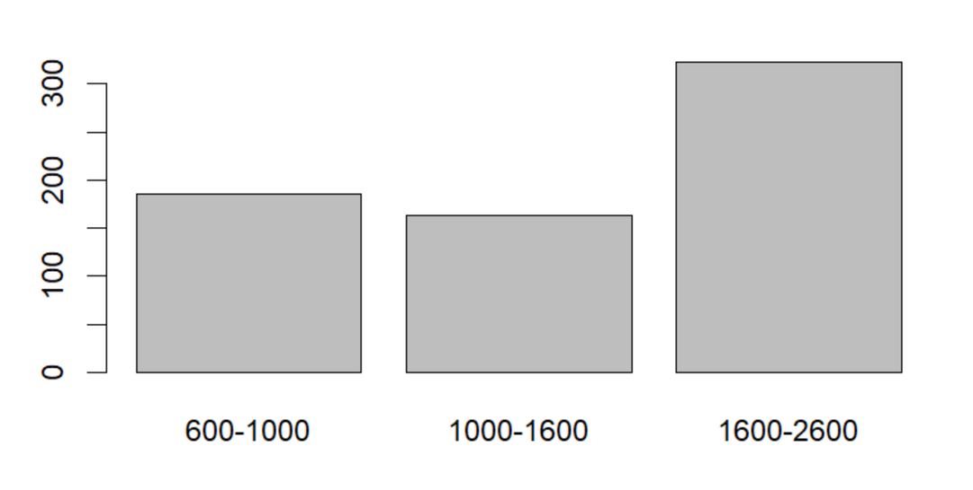
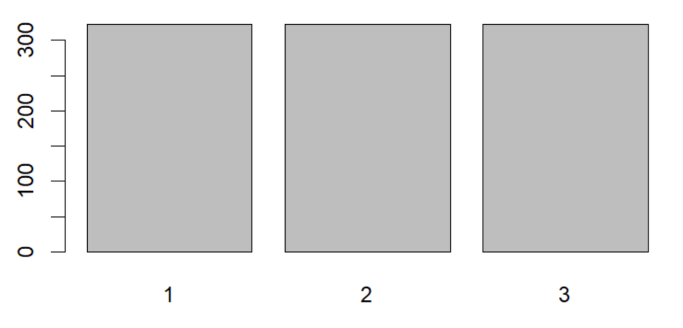
Imbalance
Before
After

Slide 14

Data Mining Techniques
Classification
Clustring
Notes:
Classification: process of categorizing or labeling data into predefined classes or categories based on its features or attributes.
Clustering: the task of grouping similar data points together based on their inherent similarities or patterns.

Slide 15


Classification
Algorithms:
Gain ratio
Gini Index
Information
Gain

Slide 16
Findings
Classification:
70% training set 30% testing set
75% training set 25% testing set
65% training set 35% testing set
IG
IG Ratio
Gini Index
IG
IG Ratio
Gini Index
IG
IG Ratio
Gini Index
Accuracy
84%
86%
84%
83%
85%
83%
81%
82%
81%
Precision
94%
98%
94%
93%
87%
93%
88%
87%
88%
Sensitivity
69%
67%
69%
69%
73%
69%
70%
65%
70%
Specificity
95%
99%
95%
94%
91%
94%
90%
92%
90%

Slide 17
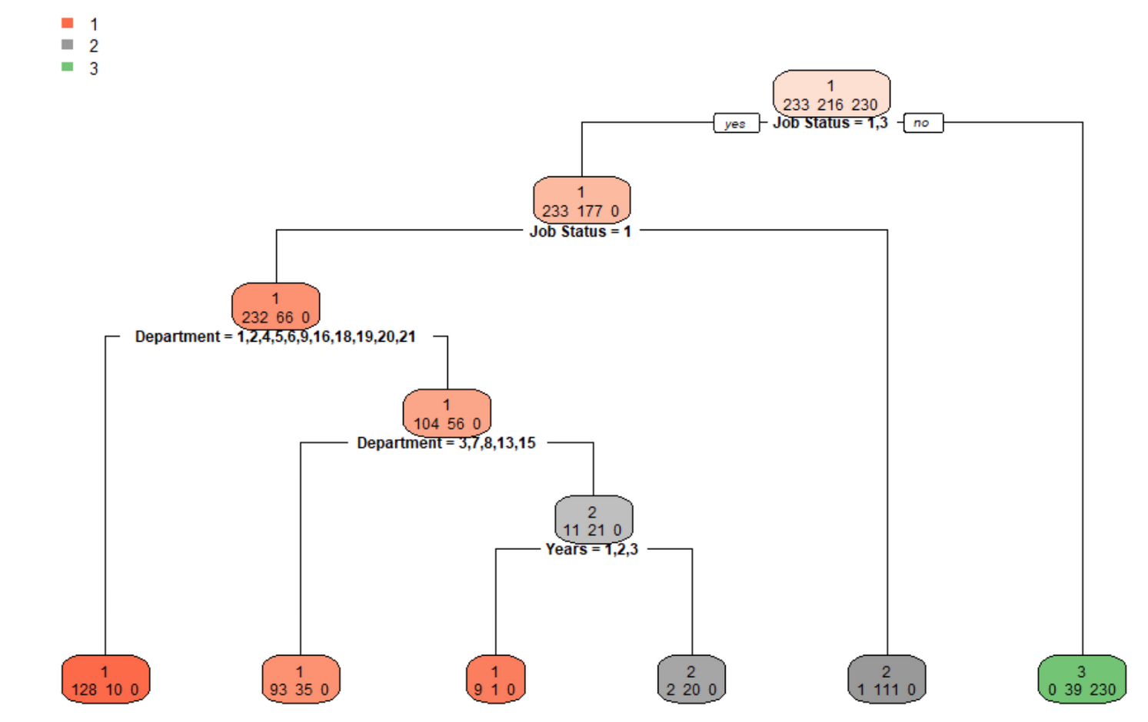


Findings
Classification:
6 Conditions

Slide 18


Clustering
How K-means algorithm is done?
Generate clusters
Represent clusters by their center points
Update the clusters’ centers
Assign objects to the closeest cluster

Slide 19
Clustering
Evaluation and Comparison
K=2
K=3
K=4
Average Silhouette width
0.3
0.25
0.22
total within-cluster sum of square
40750.1
34529.21
29822.08
BCubed precision
0.3349891
0.3352973
0.3362805
BCubed recall
0.512721
0.3487142
0.2555154

Slide 20
Clustering
Partition our data using k-mean algorithm:
We tried three different k-mean values (2,3 and 4).
2.Cluster evaluation:
We calculated the average silhouette width, total within cluster sum of square and BCubed (precision and recall).

Slide 21
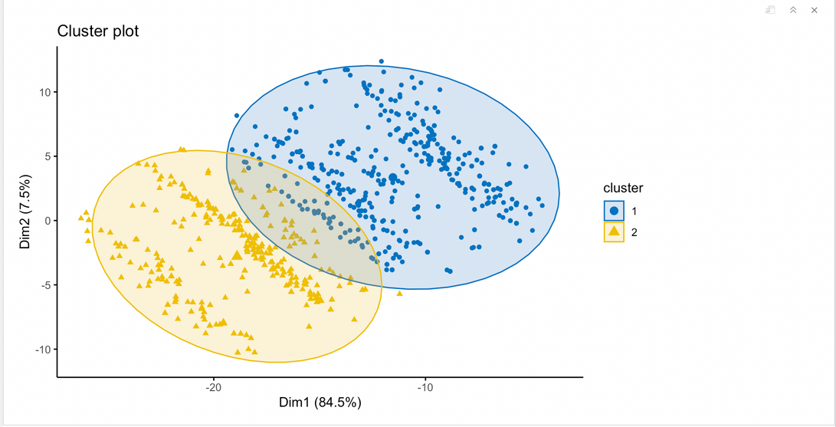
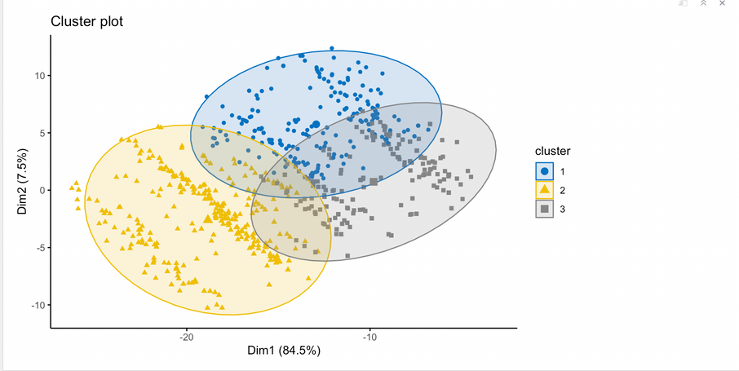
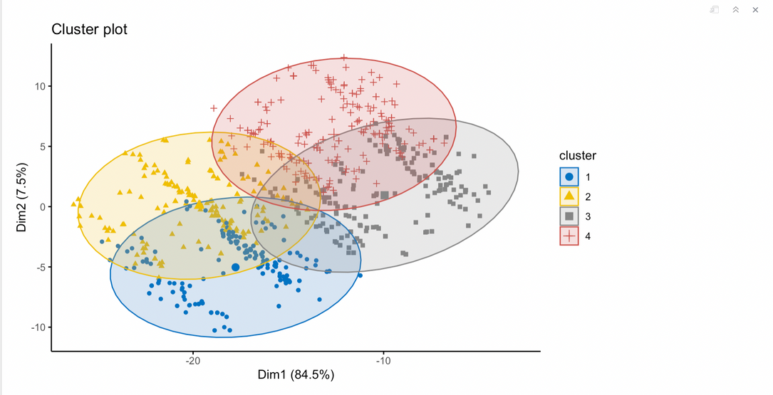
Clustering
Partition our data using k-mean algorithm:
k=2
k=3
k=4

Slide 22

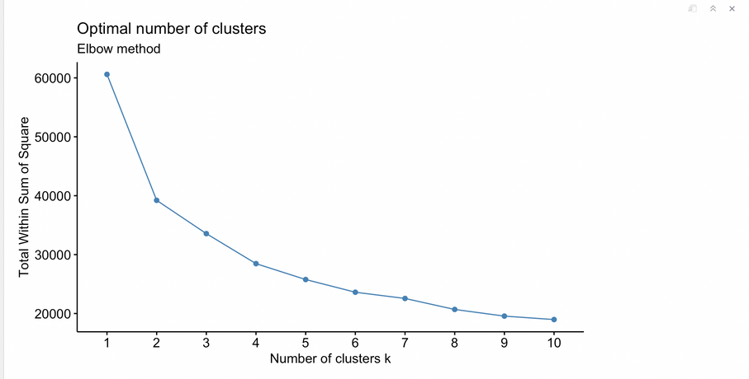
Findings
Clustring:
Average silhouette width = 0.3
Total within cluster sum = 39732.43
k=2
BCubed (precision) = 0.3349891
BCubed (recall) = 0.512721

Slide 23


Classification
What is the best to predict Salary?
Clustering

Slide 24
Thank you!
Do you have any question?

